Slide 1





Slide 2

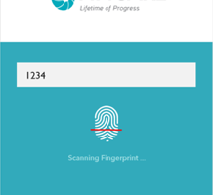



A I
FINCARE
1234
EFFICIENCY

